Slide 1
JaPAN USEd cars price prediction
Presented by – Eklavya Yaadav
(AI/ML Intern)

Slide 2
CONTENT:
1. INTRODUCTION
2. DATASET OVERVIEW
3. EXPLORATORY DATA ANALYSIS (EDA)
4. FEATURE ENGINEERING
5. MODEL APPROACH
6. MODEL EVALUATION
7. CONCLUSION

Slide 3
INTRODUCTION
The global rise in used car transactions, particularly in Japan, highlights the need to understand price determinants like brand, model, condition, mileage, and additional features.
This study aims to predict used car prices using a dataset with ten features, including price, brand, model, registration year, mileage, engine capacity, transmission type, drive type, hand drive orientation, and fuel type.

Slide 4
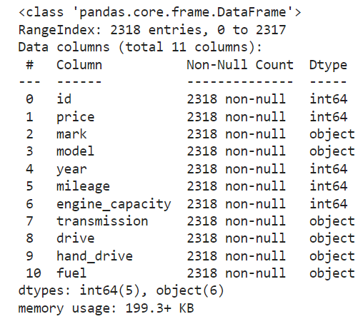
DATASET
The dataset consists of 2,318 rows and 11 columns, providing detailed information on various features of used cars.
The dataset includes ten key features: Price, Brand (Mark), Model, Year, Mileage, Engine Capacity, Transmission Type, Drive Type (2WD, 4WD, AWD), Hand Drive Orientation (Right, Left, Centre), and Fuel Type (Petrol, Diesel, Hybrid, LPG, CNG).
The primary focus of the analysis is on predicting the car's Price based on the other features.

Slide 5
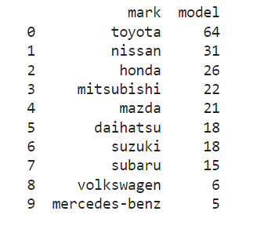
EXPLORATORY DATA ANALYSIS
Number of models of different Companies

Slide 6
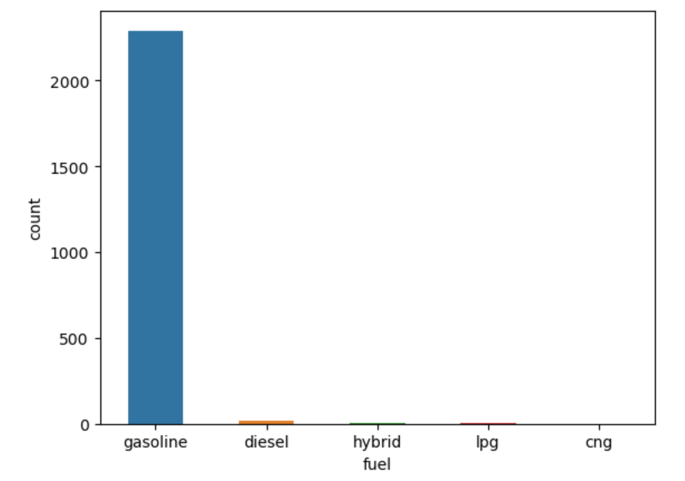
Gasoline cars tend to be more compared to other fuel types.

Slide 7
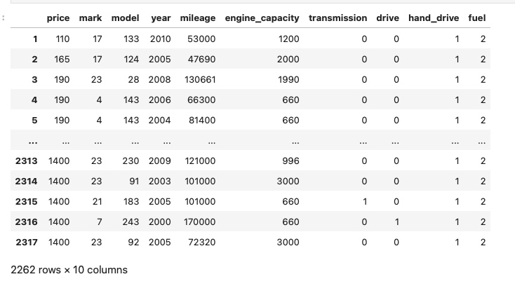
FEATURE ENGINEERING
HANDLING CATEGORICAL VARIABLES:
The dataset contains several categorical features, such as Brand, Model, Transmission, Drive Type, Hand Drive, and Fuel Type. To convert these categorical features into a numerical format that machine learning models can process, we used Label Encoding.

Slide 8
MODEL APPROACH
In this project, we explored Five different machine learning algorithms to predict the price of used cars: Linear Regression, Decision Tree Regressor, Random Forest Regressor, Ridge, and Lasso. Each algorithm has its unique strengths and is suited to different types of relationships in the data.
To ensure that our models are reliable and can generalize well to unseen data, we split the dataset into training and test sets. The training set is used to fit the models, while the test set is reserved for evaluating their performance. This process helps in selecting the best model and tuning hyperparameters, ultimately leading to more robust predictions.

Slide 9
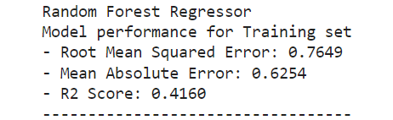
CONCLUSION
The Random Forest Regressor emerged as the best model for predicting used car prices. Its ensemble approach, which combines the predictions of multiple decision trees, allowed it to capture complex relationships in the data, resulting in the most accurate and reliable predictions among the models tested as it has 0.41 R2 score.

Slide 10
THANK YOU

